Slide 1
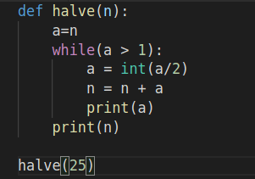
Compiler
High & low-level language:-
High-level language:-
-python – java – C++
-easy to read.
-used widely for programming.
-can run on any platform.
-need a compiler or interpreter for a translation.
-source language ==

Slide 2

Compiler
High & low-level language:-
low-level language:-
-Machine / Assembly language.
-Hard to write.
-need an assembler for translation.
-not commonly used nowadays in programming.

